Slide 1
ROCO504 A Soft Touch CDR
Group 2: A-Team
Jake Shaw-Sutton, Isaac Chasteau, Khaian Marsh

Slide 2
Introduction
Design alterations
Positional control
Control Algorithm
Variable compliance
Limitations

Slide 3
Design Alterations

Slide 4
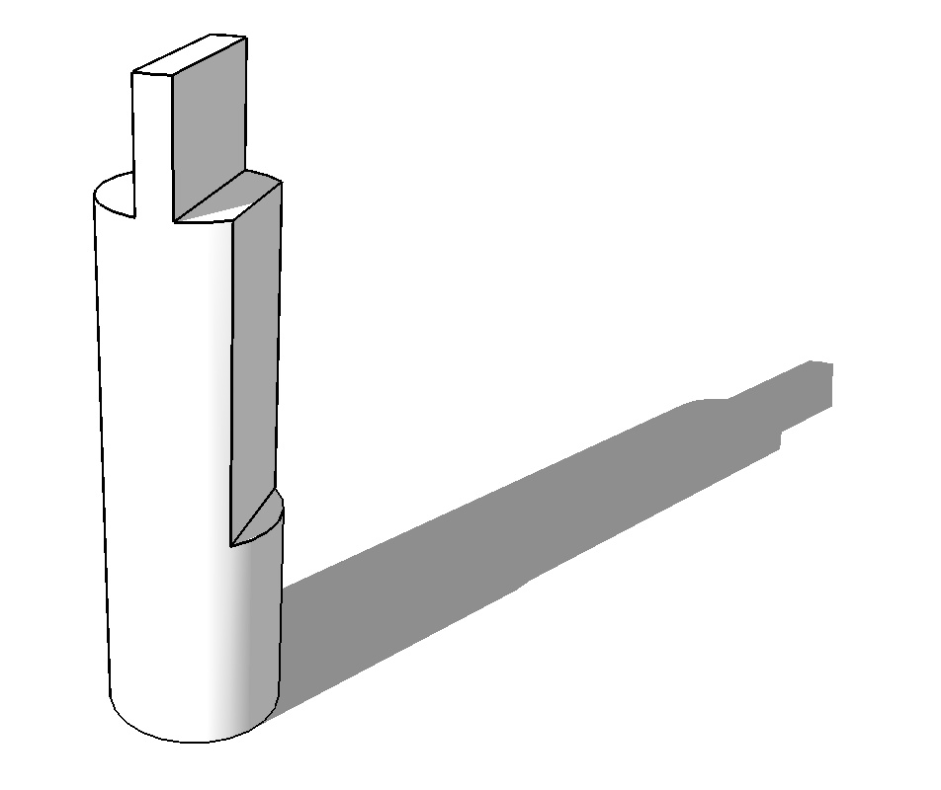
Pins

Slide 5
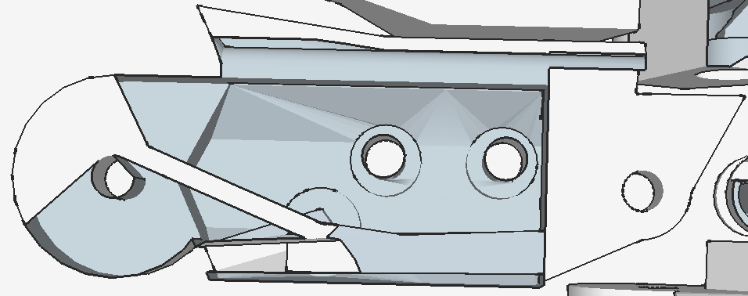
Tendon Guide channels

Slide 6
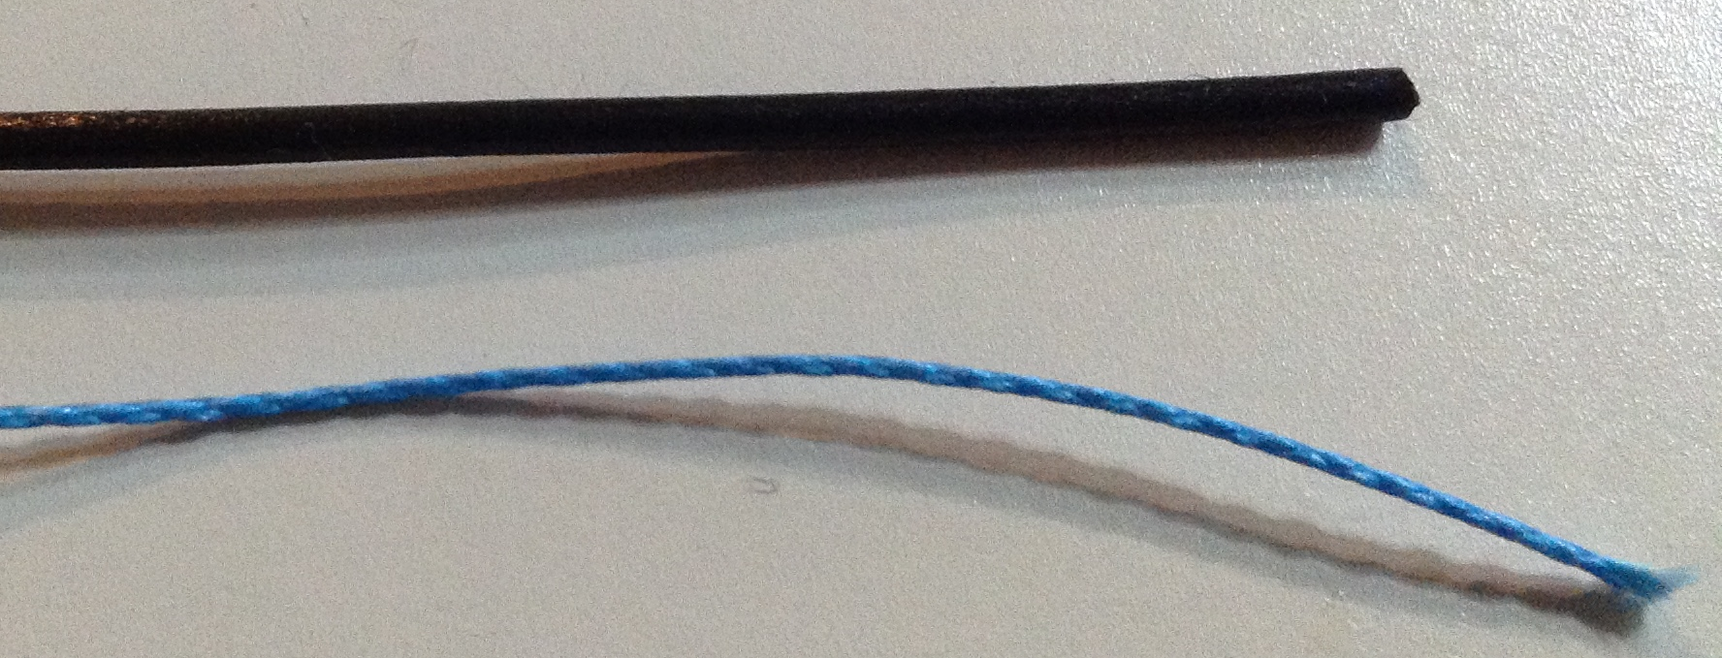
Tendon composition

Slide 7
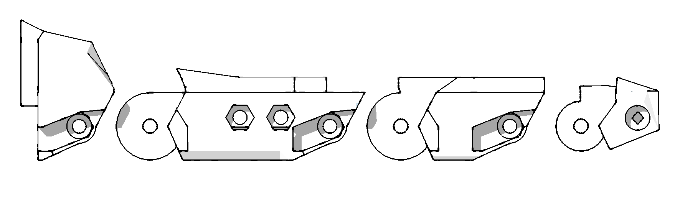
Finger Joint proportions

Slide 8
Control Algorithm
2x Modified PID controllers
MCP and Proximal joint feedback
Decaying Integrals within target bounds
Proportionally scaled with respect to each others outputs
3 separate PWM cycles generated
Proportional Pulsed Active Positioning

Slide 9
Proportional Pulsed Active Positioning

Slide 10

https://www.kpopvine.com/wp-content/uploads/PPAP.jpg

Slide 11
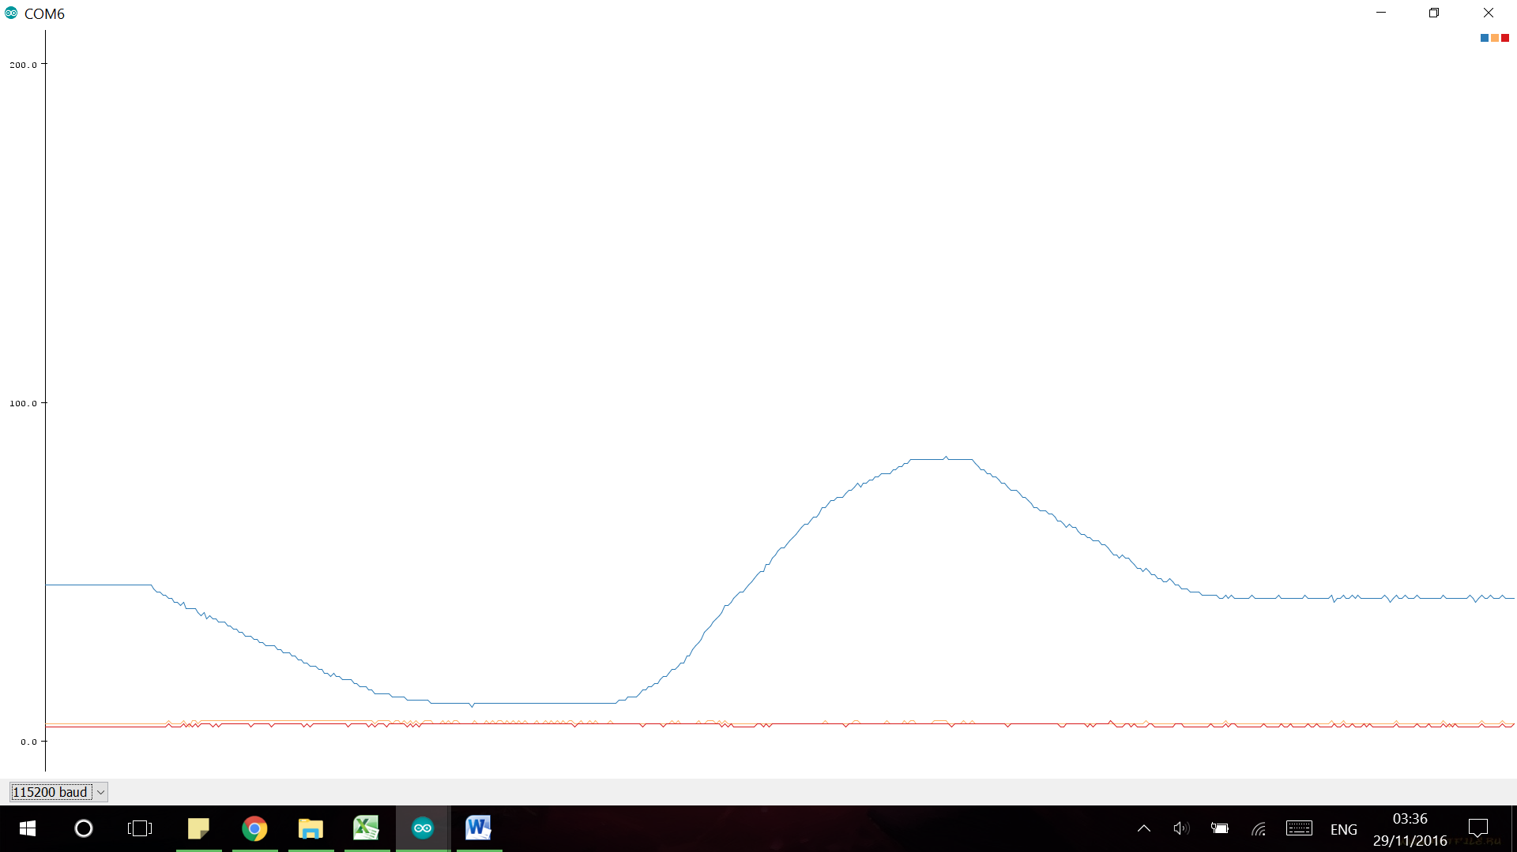
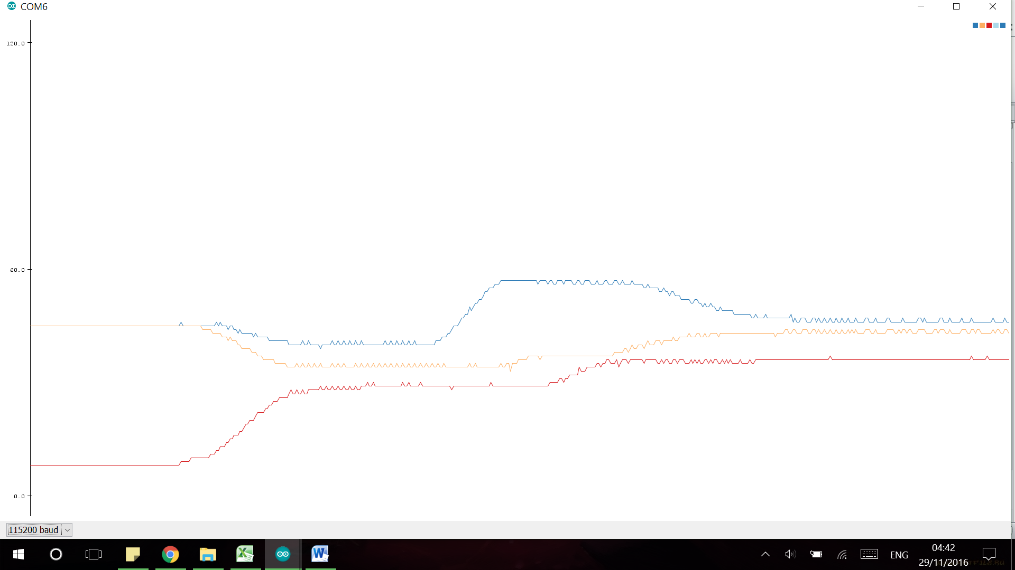
MCP Positional correction
MCP and Distal Positional correction
Blue: MCP Orange: Proximal Red: Distal

Slide 12












Inverse Kinematics
Y+
$$x_{2}$$
$$ext=\sqrt{x^{2}+y^{2}}$$
$$φ=\cos^{−1}\left(\frac{l_{2}^{2}+l_{1}^{2}−ext^{2}}{2∙L_{2}∙L_{1}}\right)$$
$$∆=\cos^{−1}\left(\frac{ext^{2}+l_{1}^{2}−l_{2}^{2}}{2∙ext∙L_{1}}\right)$$
$$δ=\tan^{−1}\left(\frac{x}{y}\right)$$
$$θ=90−δ−∆$$
$$ω=180−φ$$
$$x_{2}=\sin\left(180−θ\right)∙L_{3}$$
$$y_{2}=\cos\left(180−θ\right)∙L_{3}$$
$$x=X_{target}−x_{2}$$
$$y=Y_{target}−y_{2}$$
$$x$$
L₃
$$y_{2}$$
$$φ$$
$$ext$$
L₂
$$y$$
$$ω$$
$$δ$$
$$φ$$
$$∆$$
L₁
$$θ$$
X+

Slide 13
Variable Compliance

Slide 14
Variable Compliance
Variable compliance is achieved via co-contraction of the tendons

Slide 15
Forced Impact Displacement with Co-contraction

Slide 16
Limitations
Touch feedback
Motor Positional feedback
Independent Distal Control
Components

Slide 17
Any Questions?

